Slide 1
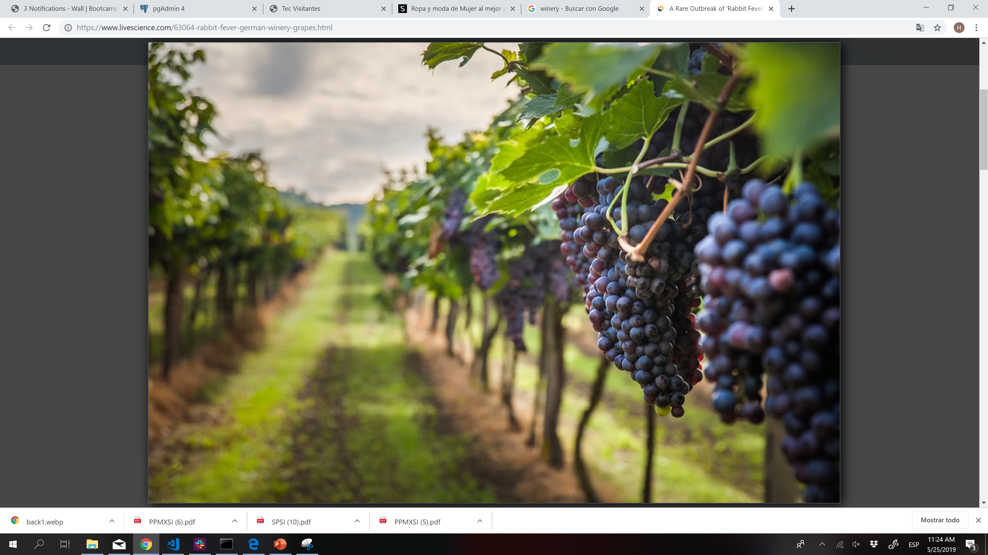
Extract, Transform, Load
Armando, Hilda, Karen, Miguel, Xavier

Slide 2
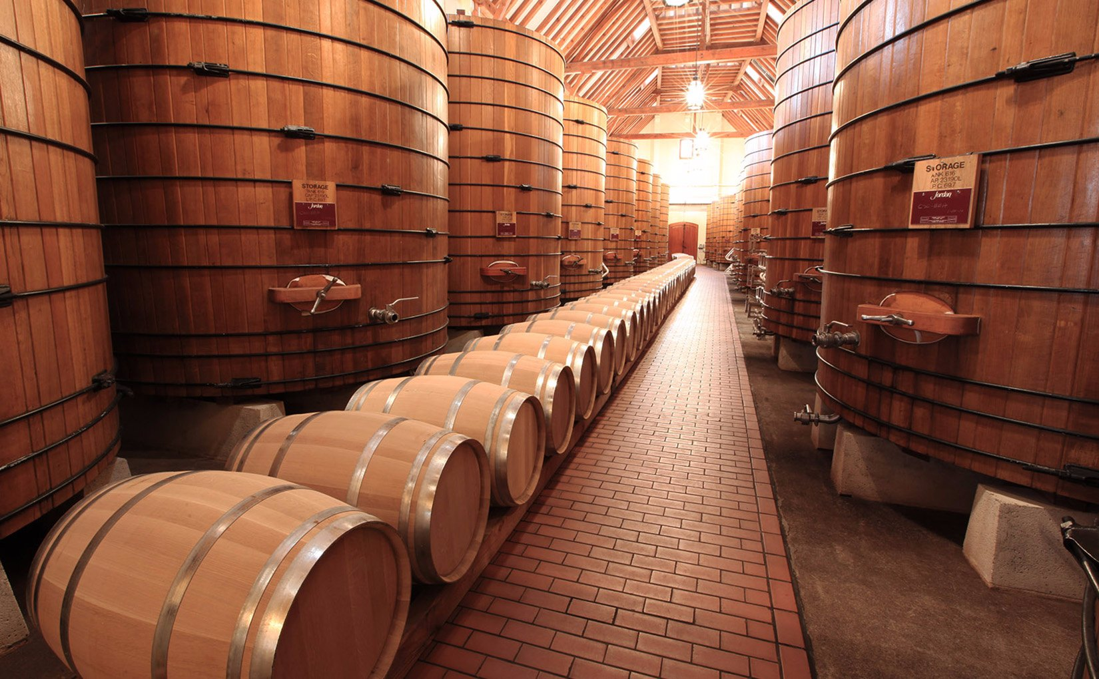
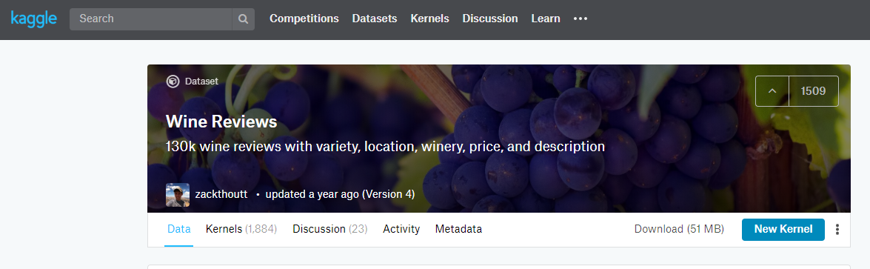
Extract
Kaggle
Wine reviews
https://www.kaggle.com/zynicide/wine-reviews
Scrapped from WineEnthusiasts.

Slide 3
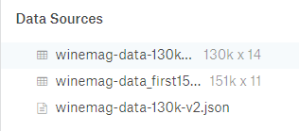
Extract
Winemag csv: country, province, region_1,region_2, title, variety, winery
Winemag json: title, description, designation, points, Price, taster_name, taster_twitter_handle.

Slide 4
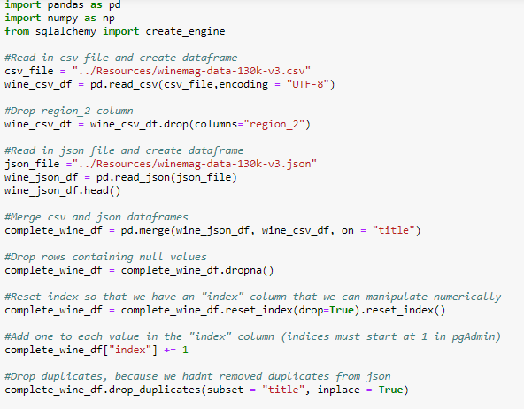
Transform
CSV
Removed repeated values
Loaded into pandas dataframe
Identify encoding: UTF-8
Remove column region_2 from csv
Json
Loaded into pandas dataframe

Slide 5
Transfrom
Merge:
Merged json and csv
Dropped null Values
Removed repeated values
Insert id, starting from 1.

Slide 6
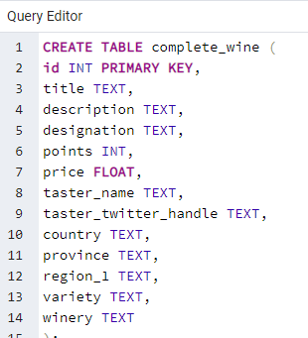
Load
pgAdmin
Create data base: wine_db
Create table: complete_wine

Slide 7
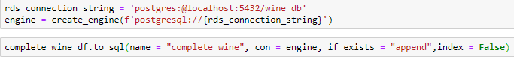
Load
Connect to data base
Insert data from pandas into database

Slide 8
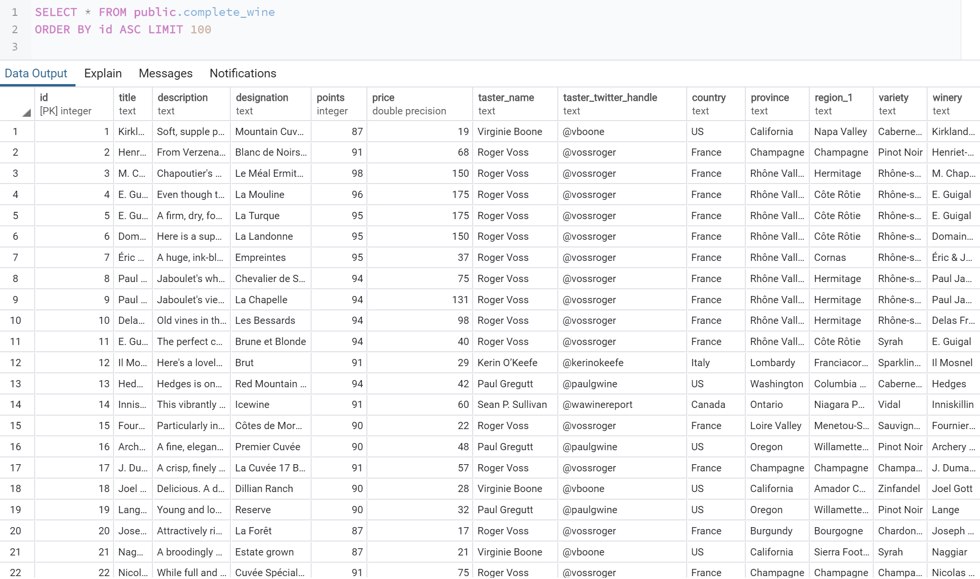
Load
Final table loaded into pgAdmin:

